Slide 1
Social Robotics
Presented by: Shim Vui Ann
12 March 2015

Slide 2
Outline
Introduction
Social Robotics in I2R
Core components: mapping and navigation
Robot development
- Cognitive robot
- Robot mapping and navigation
- Vision guided robot
Conclusion

Slide 3
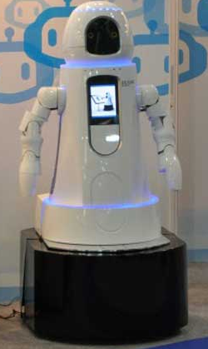
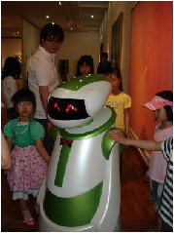
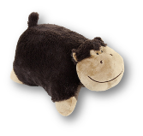
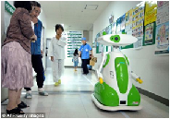
What is social robot?
Have a physical embodiment
Autonomous
Interact with humans
Understanding of social beings
HuGGler – Pet Robot
affordable & low maintenance
Notes:
Note: The robot is in Aizu Chuo Hospital in Fukushima made by Tmsuk Co. Ltd

Slide 4
Robot Development Trends
Personal Service Robots
Comprehension & Safety
Professional Service Robots
Adaptability
Military robots
Mobility
Ultimate Goal!
Industrial robots
Planning & Control

Slide 5

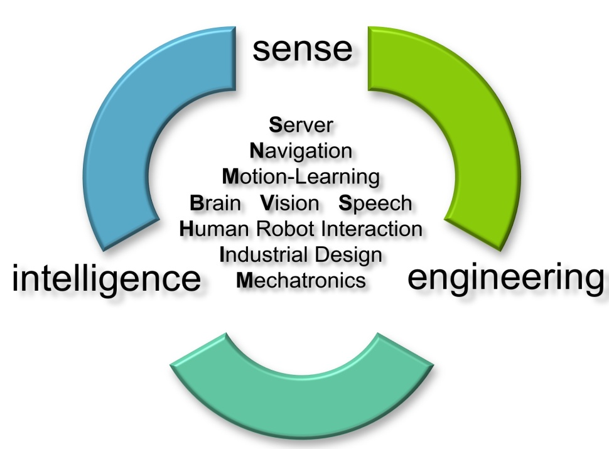
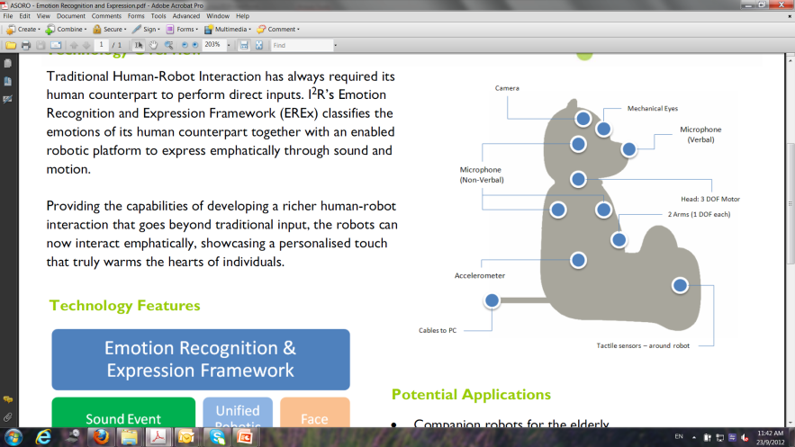
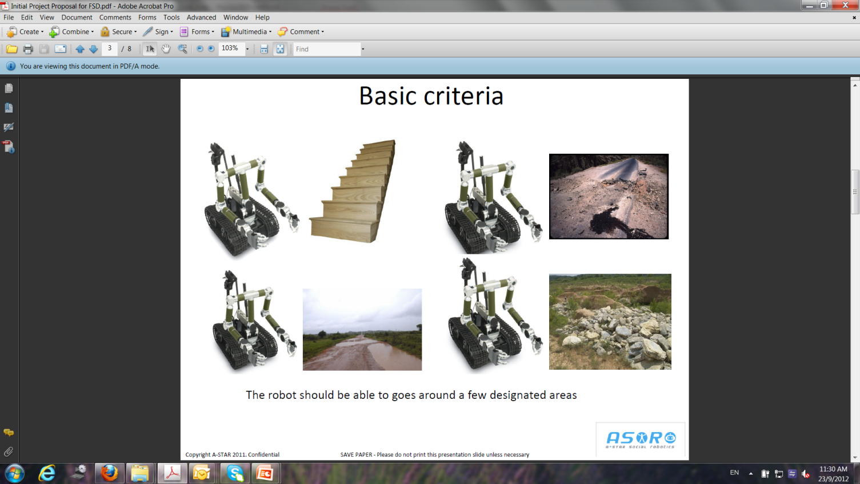
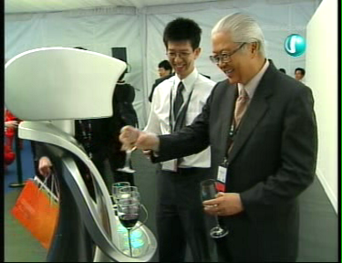


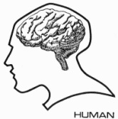
Social and Service Robotics
Robotic Attention
Sound localization
Robotic audition & vision
Human-robot dialogue
Robotic operating system (Brain)
Cognitive learning
OLIVIA 2.0
MIKA
Robotic
Cognition

Slide 6
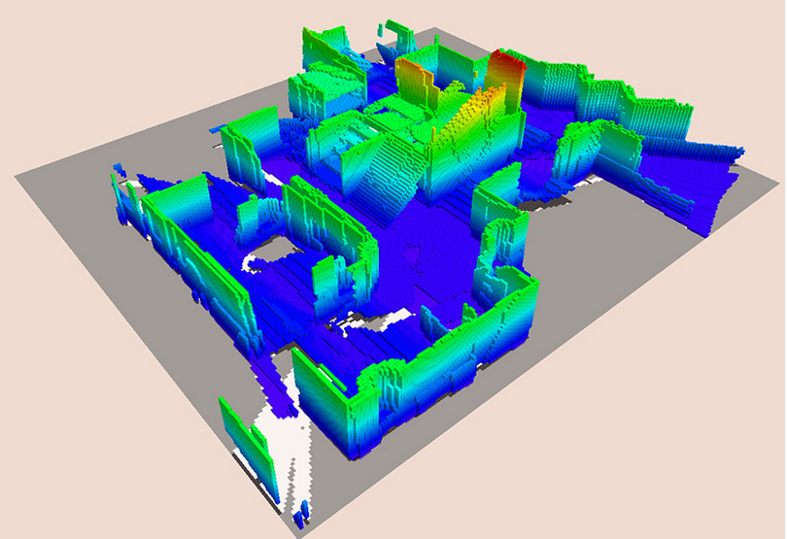
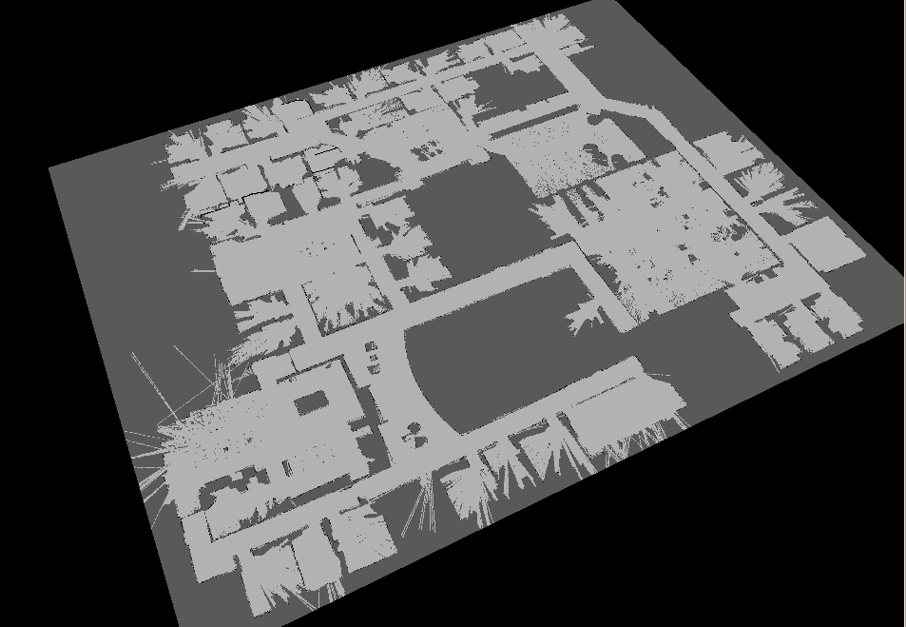
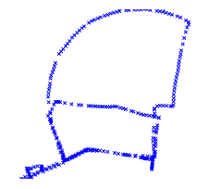
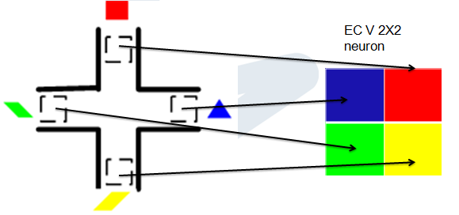
Mapping
Occupancy-based SLAM
- Features: very detail information of the physical environment is required to construct the ground-truth map, accurate representation
Appearance-based SLAM
- Features: Only record partial information of the environment to construct topological map
Neuronal Activities
- Features: Spatial information - in neuronal activities

Slide 7
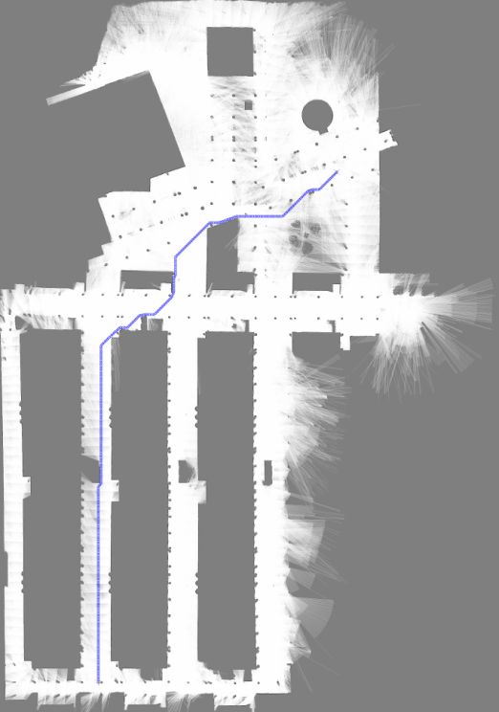
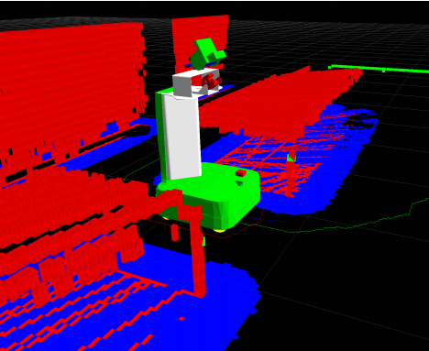
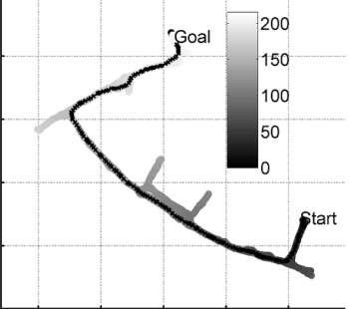
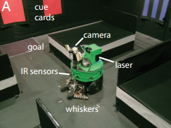
Navigation
Voxel-based 3D mapping (Eitan et al. 2010)
- Map: Used occupancy grid to build costmap
- Cons: Detailed environmental data is required, slow
RatSLAM (Milford and Wyeth 2009)
- Map: Topological’s cognitive map
- Cons: Need to follow closely the global path
Darwin XI (Fleischer et al. 2007)
- Map: Location as neuronal activities
- Global planner: No.
- Cons: Small area

Slide 8
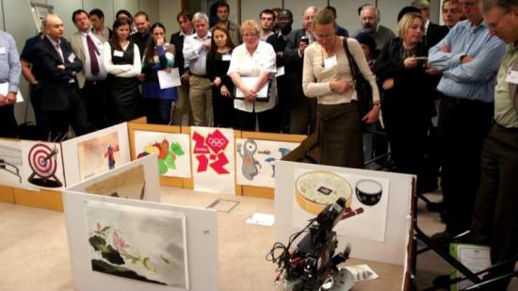
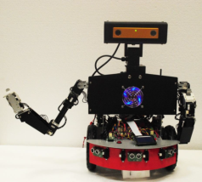
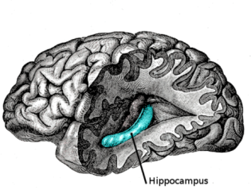
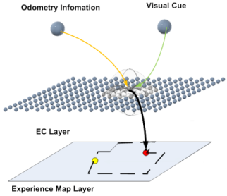
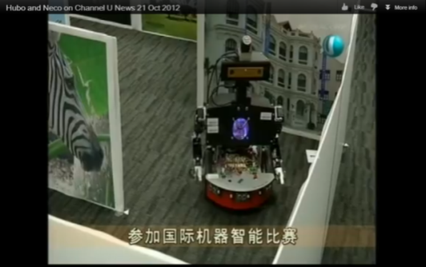
Neural Cognitive Robot (NECO)
Robot Platform
+
Peripheral Algorithms
Sensors
Actuators
Manipulation
Communication
The robot is able to navigate in very complex unknown environments through active cognition.
+
Brain Based Model
Discovery of navigational cells in brain
Applicable Computational Model based on brain structure and function

Slide 9
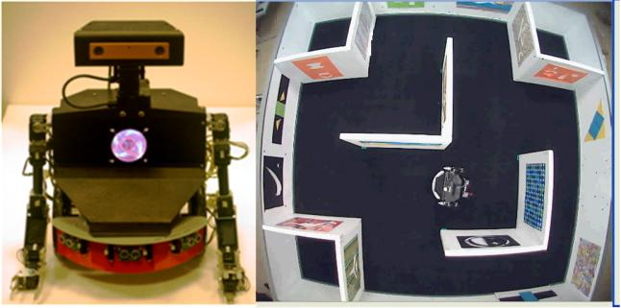
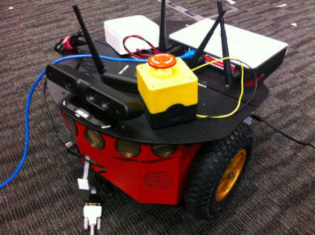
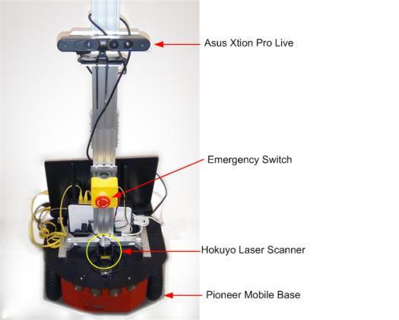
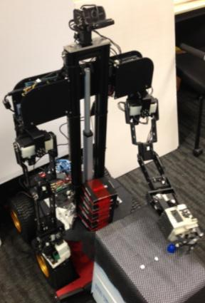
NECO Series
NECO I and the maze environment
NECO II, preliminary setup
NECO III, in development
NECO II, current setup

Slide 10
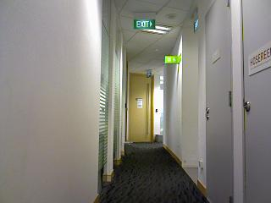

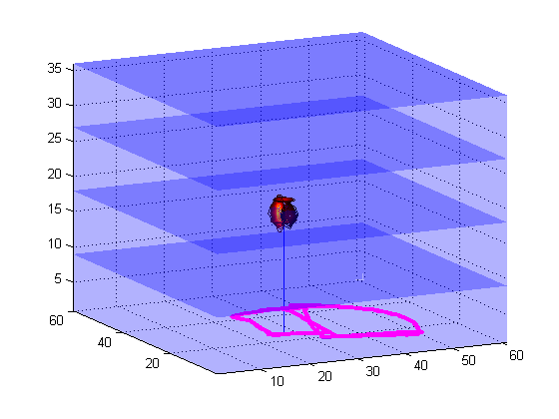
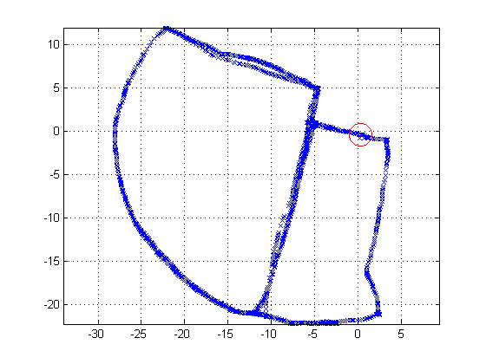
Association example
Visual template
Pose cell network
Experience map and grids

Slide 11
Research Map
Neuro-Cognitive Systems
capable of learning and adaptation
Micro-level:
Neural Circuits
Macro-level:
Intelligence
Memory Coding
Neco
NEural COgnitive Robot
Associative
Memory
Episodic
Memory
Brain Based Model
Synaptic Learning
Neural Coding
Notes:
Research map of our group. But today I am going to introduce Neco only.

Slide 12
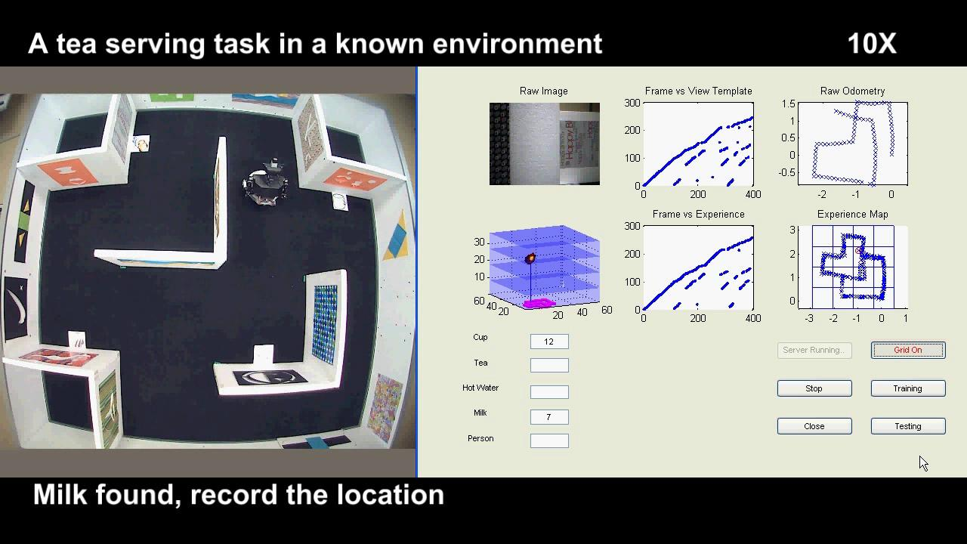
Cognitive mapping in maze

Slide 13
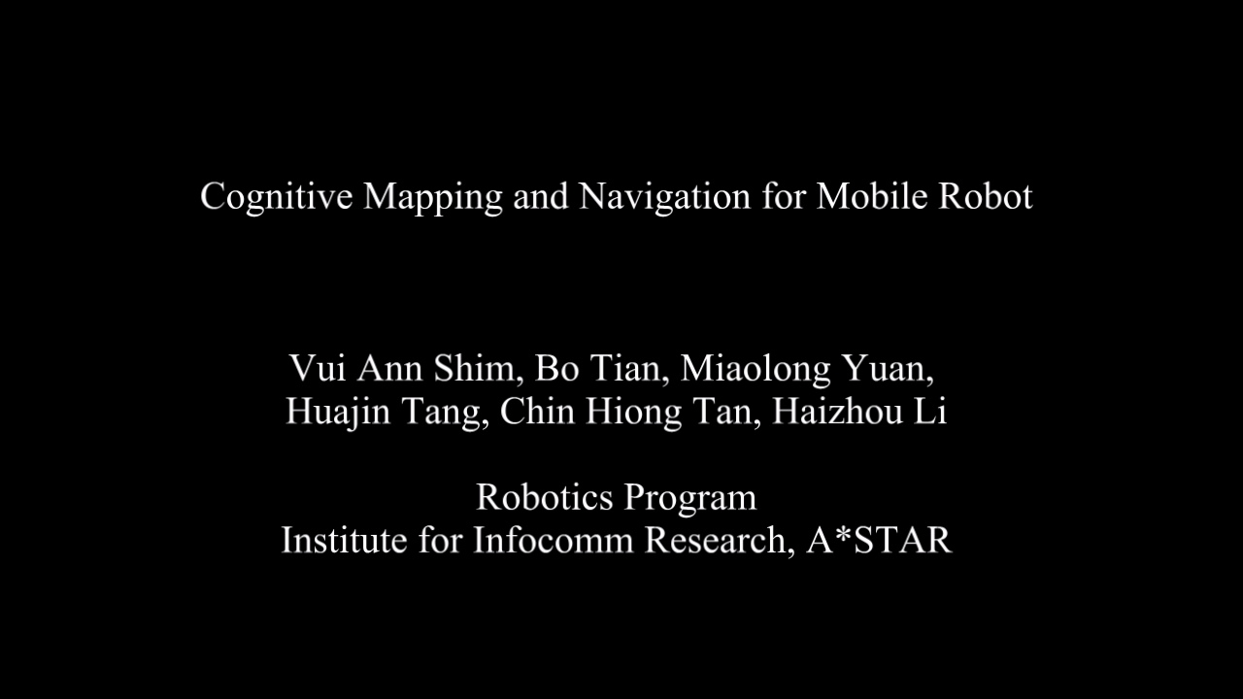
Cognitive mapping in office

Slide 14
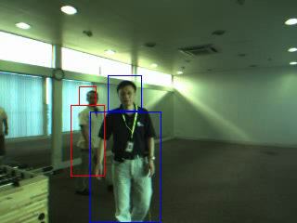
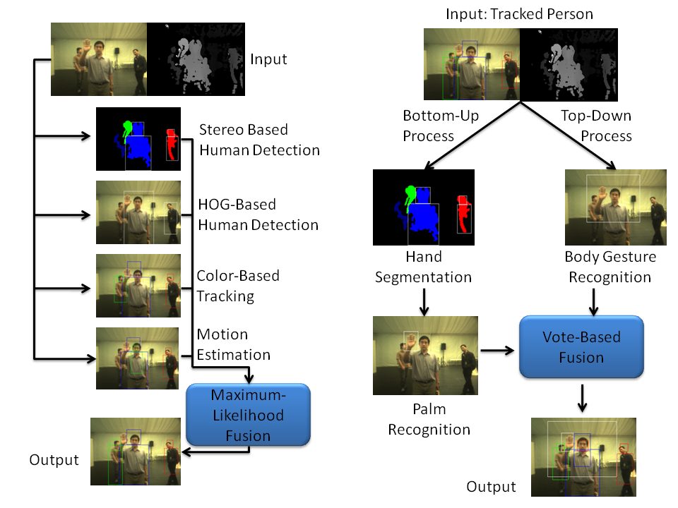
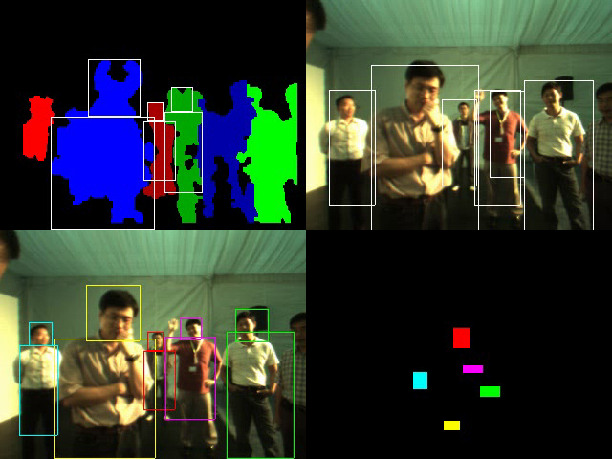
Human & Gesture Tracking
Human Tracking
Gesture Tracking
Click for video
Stereo-based human detection
HOG-based human detection
Robust fusion of information from 4 human detection, tracking, and estimation models
Bottom-up hand gesture detection & recognition
Stereo-based segmentation
Skin and palm verification
Top-down body gesture detection
HOG-based body gesture detection
Click for video
Notes:
Novel tracking algorithm integrating multi-model detection and mean-shift tracking
Detection improvement: 80%-->90%; Tracking error through occlusion reduced from 27.6% to 8.1%
HOG stands for Histogram of Oriented Gradients

Slide 15
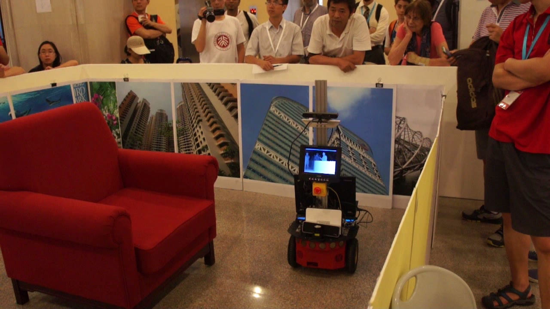
Gesture recognition

Slide 16
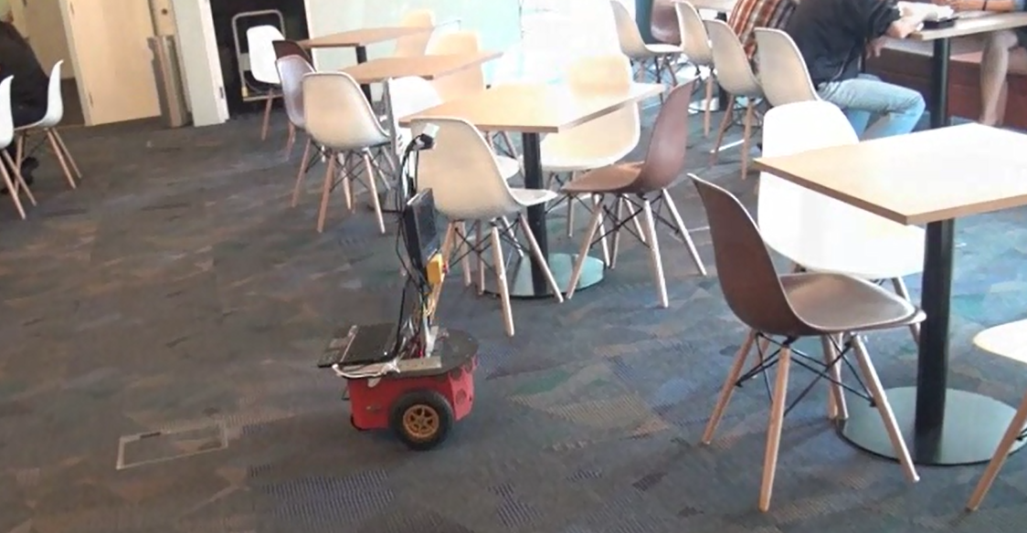
Automatic object searching

Slide 17
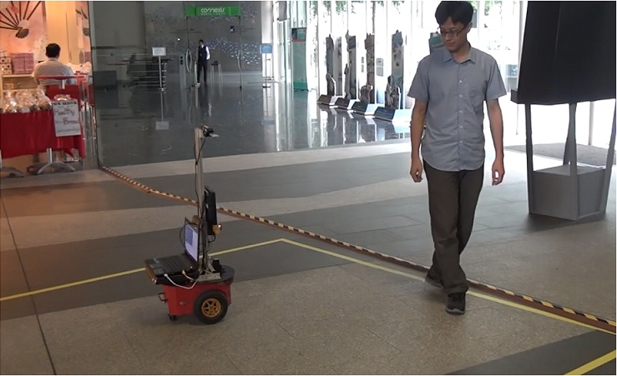
Following people

Slide 18
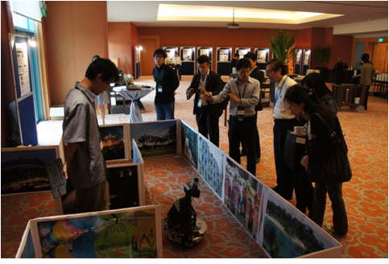
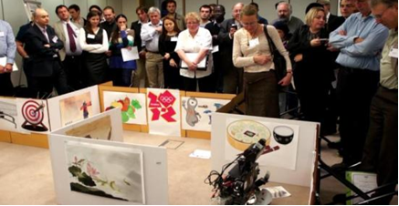
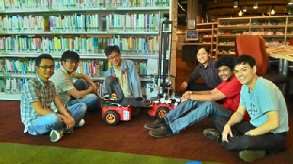
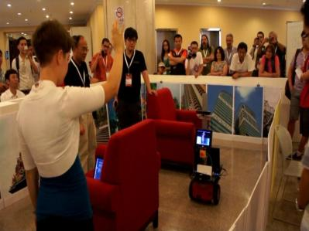
Outside the lab
@ London
@ Sentosa
@ Serangoon Library
@ Beijing

Slide 19
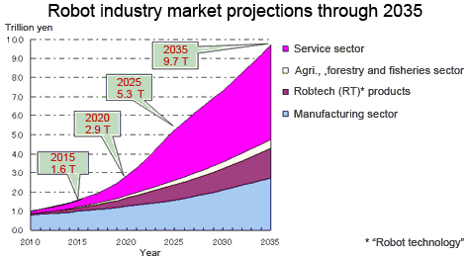
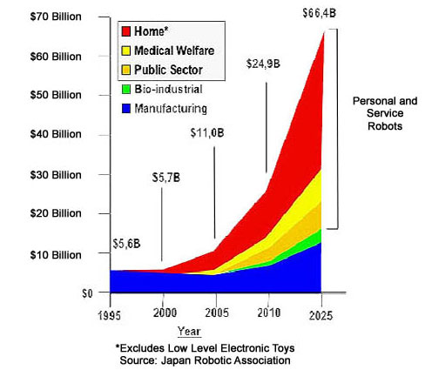
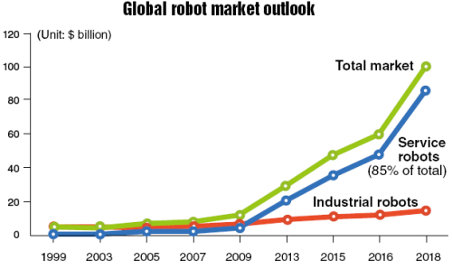
Conclusion
Notes:
The Ministry of Economy, Trade and Industry (METI) and the New Energy and Industrial Technology Development Organization (NEDO) japan
http://www.roboticsbusinessreview.com/article/webcast_investing_in_robotics_for_20151

Slide 20
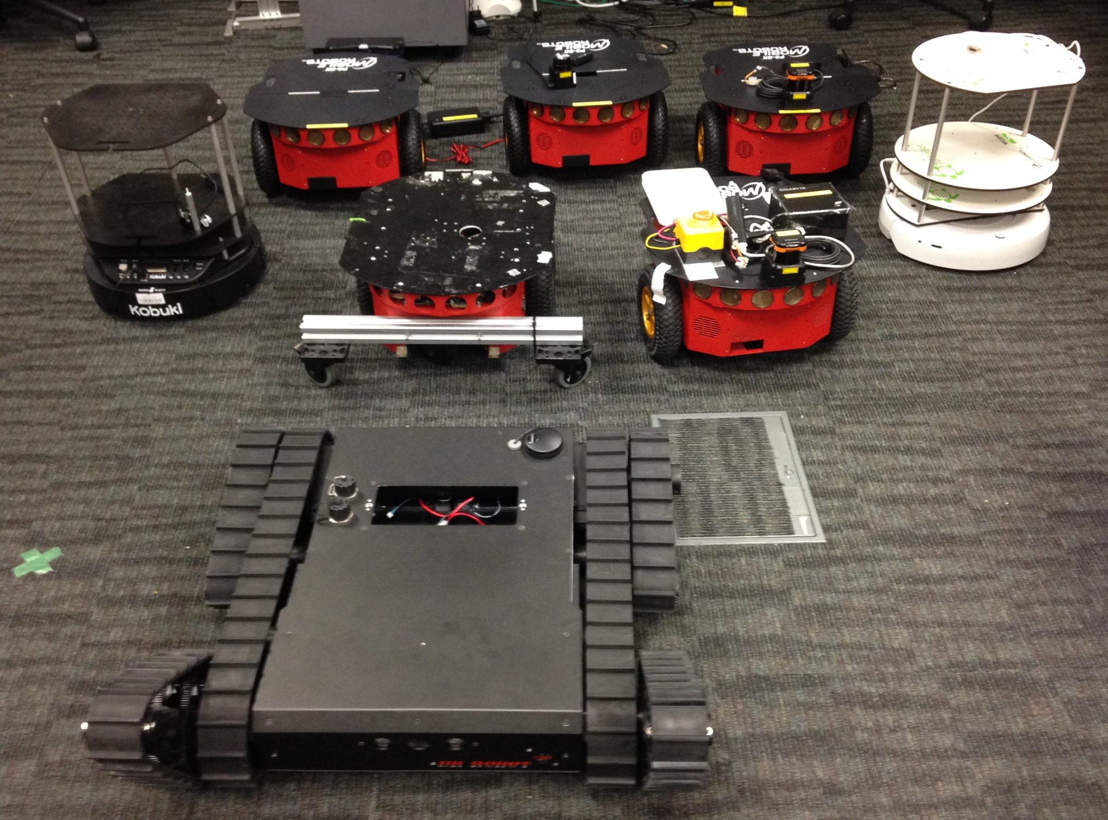
Future
Notes:
The Ministry of Economy, Trade and Industry (METI) and the New Energy and Industrial Technology Development Organization (NEDO) japan
http://www.roboticsbusinessreview.com/article/webcast_investing_in_robotics_for_20151

Slide 21
Thank You

